Slide 1
Instant Payments Adoption
Outlook: QUANTITATIVE SURVEY of
U.S. Financial Institution Enablers
FasterPaymentsCouncil.org
© 2024 U.S. Faster Payments Council. Materials are not to be used without consent.

Slide 2
Table of contents
Section | Topic | Page Number
Introduction | Why this study? | 3
 | Executive summary | 4
Core report | Adoption outlook | 5
 | Use case summary | 6
 | Use case details | 7-9
 | Instant payment benefits | 10–11
 | Headwinds and tailwinds | 12
 | Next steps: priority actions | 13
 | FPC workstream alignment | 14
Appendix | Objectives and methodology | 15–16
 | Industry resources | 17
 | Use case supplement | 18-21

Slide 3
Why this study?
With recent increases in the number of institutions adopting faster and instant payments and the need to help bring these services to the fuller market, it is important to get a more quantitative baseline of adoption, drivers, headwinds, tailwinds and quantified insights to next priorities.
Information
available
Types of current
information
Quantifying
market-wide view
The FPC’s Faster Payments Barometer has provided critical early information to the industry, leveraging the value of industry leaders across the ecosystem.
Meanwhile, the insights from the Faster Payments Barometer and other studies are not necessarily representative of the broader market. Various stakeholders are increasingly asking for these types of more representative and quantitative insights.
Survey of third-party providers to U.S.-based
institutions created to better understand their insights with implementing faster/instant payments.

Slide 4
Executive summary
Survey of 25 core banking providers and payment processors, supporting 90% of U.S.-based financial institutions (FIs), documents progress in instant payment activation, especially with the ability to receive first.
Respondents estimate that between 70% and 80% of all FIs will be enabled to receive instant payments by 2028.
They also estimate between 30% and 40% of FIs will be enabled to send instant credits by 2028, contingent upon anticipated progress being made as outlined in this report.
Results also quantify third-party providers’ assessment of use case priorities, benefits, challenges and opportunities for instant payment adoption.
Important progress
2. Adoption Outlook
3. Significant work ahead
U.S. market has mobilized adoption with availability of multiple faster and instant payment options.
Between 70% and 80% of all financial institutions are expected to be receiving instant payments, and between 30% and 40% of all financial institutions sending instant payments, by 2028.
Near term benefits: Digital wallet funding, payroll, earned wage access, P2P, online banking bill pay.
Longer-term benefits: Emergency government payments, B2B invoicing, P2B request-for-payment.
Opportunities exist to innovate, differentiate, and expand customers.
Use cases with higher availability and higher benefit take additional work, building on foundations realized to date.
Headwinds (slowing): Growing network reach, more ubiquitous alias tool availability, expanded fraud tools, error resolution, and user interface integration
Tailwinds (helping): Use case-driven approach, training/documentation, and rules and standards

Slide 5
Quantifying adoption outlook: Steady year-by-year growth in institutions receiving instant payments
Respondents expect between 70% and 80% of U.S.-based FIs to be receive-enabled participants by 2028, helped along by activation of strategic use cases, including:
Mobile wallet funding/defunding
Earned wage access
Government disbursements
The charts below includes 95% confidence intervals to highlight the natural uncertainty.
Respondents expect between 30% and 40% of U.S.-based FIs to be sending instant payments by 2028, influenced by:
Availability of fraud tools
Availability of ubiquitous alias tools
Pace of integration into end-user interfaces
Continued growth in receiving institutions
New use cases generating additional volume/benefits
FIs Receiving Instant Payments
FIs Sending Instant Payments
About how many of the total U.S.-based financial institutions do you think will be participating actively as either receive-only or receive and send financial institutions?

Slide 6
Use case prioritization: Summary
The use which are expected to activate soonest included earned wage access, wallet funding and P2P.
The use cases that are expected to achieve the broadest reach include earned wage access, payroll funding, and invoice/supplier payments.
The use cases that are expected to deliver the greatest benefit include payroll, earned wage access, B2B payments, and government emergency payments, helping grow network reach.
1. Use cases
SOONEST to realize
2. Use cases with GREATEST REACH
3. Use cases delivering GREATEST BENEFIT
B2P – Earned wage access
B2P – Digital wallet funding/defunding
P2P – Friends and family
B2P – Earned wage access
B2B – Payroll funding
B2B – Invoice supplier payments
B2P – Payroll and earned wage access
Govt. – Emergency payments
B2B – Invoices and supplier payments
Which use cases will have the most impact on instant payments adoption in terms of market reach/market participation (niche vs. broad) and in terms of the benefit gained from the instant payment use case (lower vs. higher benefit)? Select one Reach option and one Benefit option for each use case.
When do you think each use case will be widely available (available to one-third (33%) or more of viable participants) using instant payments? Select one option for each use case.

Slide 7
Use case prioritization: Detailed results
Respondents shared detailed views into the timing, reach and relative benefits of different use cases. The green shading notes use cases which enablers selected as a “top-3” priority. Looking across the combined assessments identify earned wage access, digital wallet funding, friends and family transactions, invoice payments, online banking bill pay, government payments and P2B, including both point of sale and e-commerce as key priorities reflecting use cases with near-term, mid-term and longer term, higher benefit.
Timing of use cases activation
Use Case | Avg Timing (3=Earliest Activation, 1=Latest Activation)
B2P - Earned wage access | 2.0 | Within 1 year
P2B - Wallet funding/defunding | 1.9 | Within 1 year
P2P - Friends and family | 1.9 | Within 1 year
B2P - Online gaming | 1.8 | Within 1 year
B2B - Merchant settlement | 1.7 | Within 1 year
B2B - Payroll funding | 1.7 | Within 2 years
B2B - Invoices and supplier payments | 1.6 | Within 2 years
G2P - Emergency payments | 1.6 | Within 2 years
B2P - Legal insurance | 1.5 | Within 2 years
A2A - Wealth mgmt transfer | 1.5 | Within 2 years
B2P - Payroll | 1.5 | Within 3 years
A2A - Cash concentration | 1.5 | Within 3 years
P2P - Household service | 1.5 | Within 3 years
B2P - Refunds | 1.4 | Within 3 years
P2B - Online banking billpay | 1.3 | Within 3 years
G2P - Govt loan disbursement | 1.3 | Within 4 years
P2B - Request for pay | 1.3 | Within 4 years
P2G - Taxes | 1.2 | Within 4 years
Intl - B2B | 1.2 | Within 4 years
G2P - Govt benefits | 1.2 | Within 4 years
P2B - Ecomm | 1.1 | More than 4 years
P2B - Digital subscriptions | 1.1 | More than 4 years
Intl - billpay & payroll | 1.0 | More than 4 years
P2B - Point of sale | 0.9 | More than 4 years
Intl - P2P | 0.9 | More than 4 years
Relative reach of use cases
Use Case | Avg Reach (3=Higest Reach, 1=Lowest Reach)
B2P - Earned wage access | 2.5 | Highest Reach
B2B - Payroll funding | 2.5 | Highest Reach
B2B - Invoices and supplier payments | 2.4 | Highest Reach
G2P - Emergency payments | 2.3 | Highest Reach
G2P - Govt benefits | 2.3 | Highest Reach
P2B - Online banking billpay | 2.2 | Mid-High Reach
P2B - Wallet funding/defunding | 2.2 | Mid-High Reach
P2P - Friends and family | 2.2 | Mid-High Reach
B2B - Merchant settlement | 2.2 | Mid-High Reach
P2G - Taxes | 2.2 | Mid-High Reach
G2P - Govt loan disbursement | 2.1 | Medium Reach
B2P - Legal insurance | 2.1 | Medium Reach
B2P - Online gaming | 2.1 | Medium Reach
A2A - Wealth mgmt transfer | 2.1 | Medium Reach
P2B - Ecomm | 2.0 | Medium Reach
P2B - Request for pay | 2.0 | Mid-Low Reach
B2P - Payroll | 2.0 | Mid-Low Reach
Intl - B2B | 1.9 | Mid-Low Reach
Intl - Billpay & payroll | 1.9 | Mid-Low Reach
A2A - Cash concentration | 1.8 | Mid-Low Reach
B2P - Refunds | 1.8 | Lower Reach
Intl - P2P | 1.8 | Lower Reach
P2B - Point of sale | 1.6 | Lower Reach
P2P - Household service | 1.6 | Lower Reach
P2B - Digital subscriptions | 1.4 | Lower Reach
Relative benefits of use cases
Use Case | Avg Benefit (3=Greater Benefit, 1= Lesser Benefit)
B2P - Earned wage access | 2.7 | Highest Benefit
G2P - Emergency payments | 2.6 | Highest Benefit
B2B - Invoices and supplier payments | 2.5 | Highest Benefit
B2B - Payroll funding | 2.5 | Highest Benefit
P2B - Request for pay | 2.4 | Highest Benefit
P2B - Online banking billpay | 2.3 | Mid-High Benefit
G2P - Govt benefits | 2.3 | Mid-High Benefit
Intl - B2B | 2.2 | Mid-High Benefit
P2B - Ecomm | 2.2 | Mid-High Benefit
Intl - Billpay & payroll | 2.2 | Mid-High Benefit
G2P - Govt loan disbursement | 2.2 | Medium Benefit
B2B - Merchant settlement | 2.1 | Medium Benefit
B2P - Legal insurance | 2.1 | Medium Benefit
B2P - Online gaming | 2.1 | Medium Benefit
Intl - P2P | 2.1 | Medium Benefit
P2B - Wallet funding/defunding | 2.1 | Mid-Low Benefit
A2A - Cash concentration | 2.0 | Mid-Low Benefit
A2A - Wealth mgmt transfer | 2.0 | Mid-Low Benefit
B2P - Payroll | 2.0 | Mid-Low Benefit
P2G - Taxes | 2.0 | Mid-Low Benefit
P2B - Point of sale | 2.0 | Lower Benefit
B2P - Refunds | 1.9 | Lower Benefit
P2P - Friends and family | 1.8 | Lower Benefit
P2P - Household service | 1.6 | Lower Benefit
P2B - Digital subscriptions | 1.3 | Lower Benefit
Which use cases will have the most impact on instant payments adoption in terms of market reach/market participation (niche vs. broad) and in terms of the benefit gained from the instant payment use case (lower vs. higher benefit)? Select one Reach option and one Benefit option for each use case.
When do you think each use case will be widely available (available to one-third (33%) or more of viable participants) using instant payments? Select one option for each use case.

Slide 8
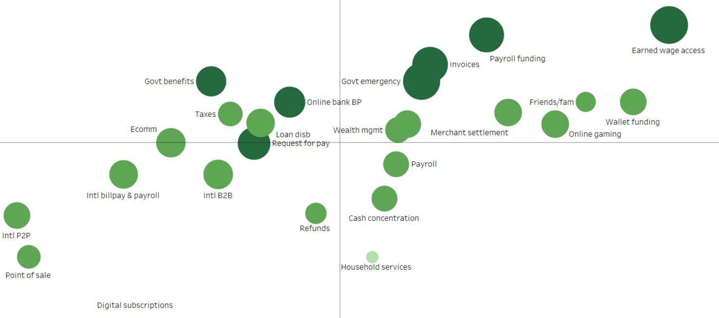
Use case insights: Detailed results in context
Respondents shared views into the timing, reach and relative benefits of use cases. The darker shaded and larger bubbles are seen as being relatively high benefit. The combined assessments identified earned wage access, payroll funding, invoice payments and government emergency disbursements as having the greatest benefit overall. Blue halo use cases indicate respondents selected them as delivering the most benefit for the least effort in the shortest time.
Higher
Reach
LARGER/DARKER BUBBLE SIZE
= Higher relative benefit
BLUE HALO
= Use cases third party enablers identified as top-3 priority
Lower
Reach
Ready Later (3-4 years)
Ready Sooner (within 1 year)

Slide 9
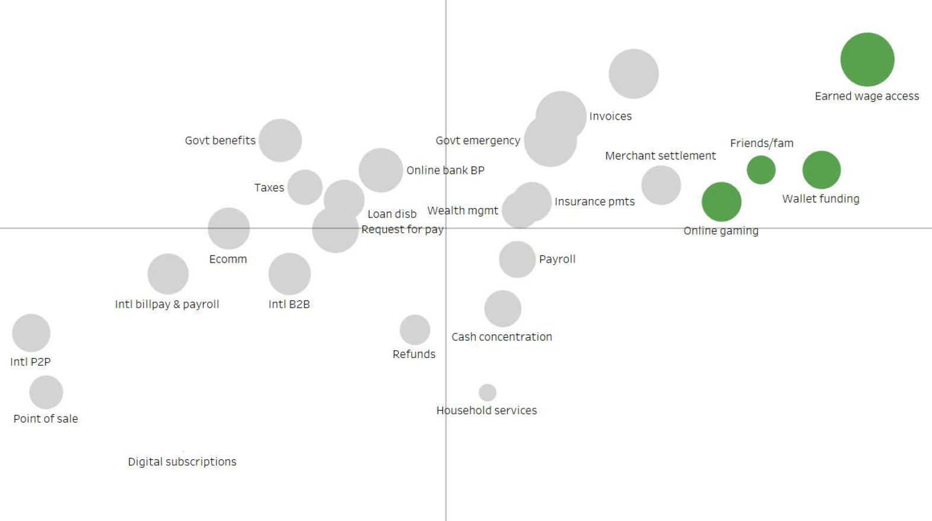
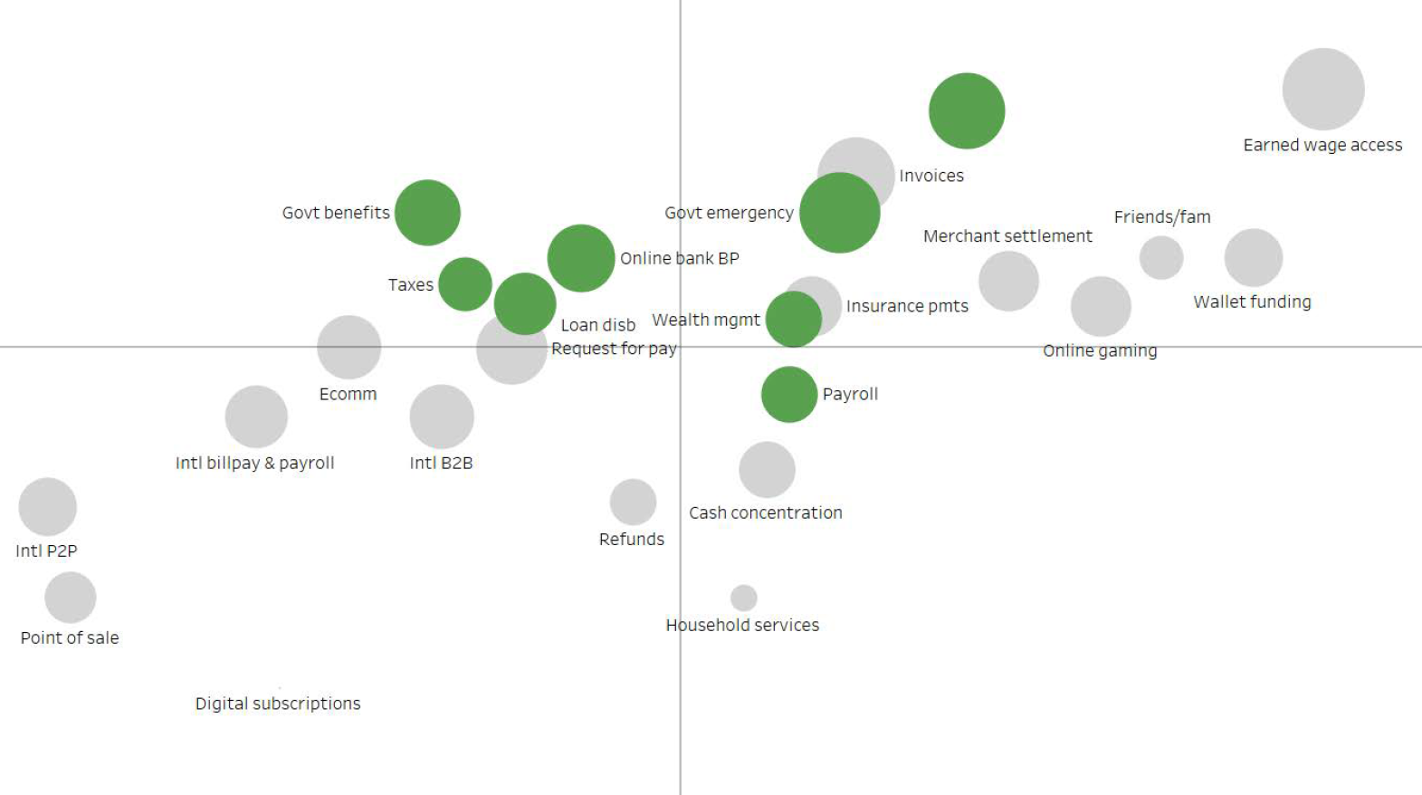
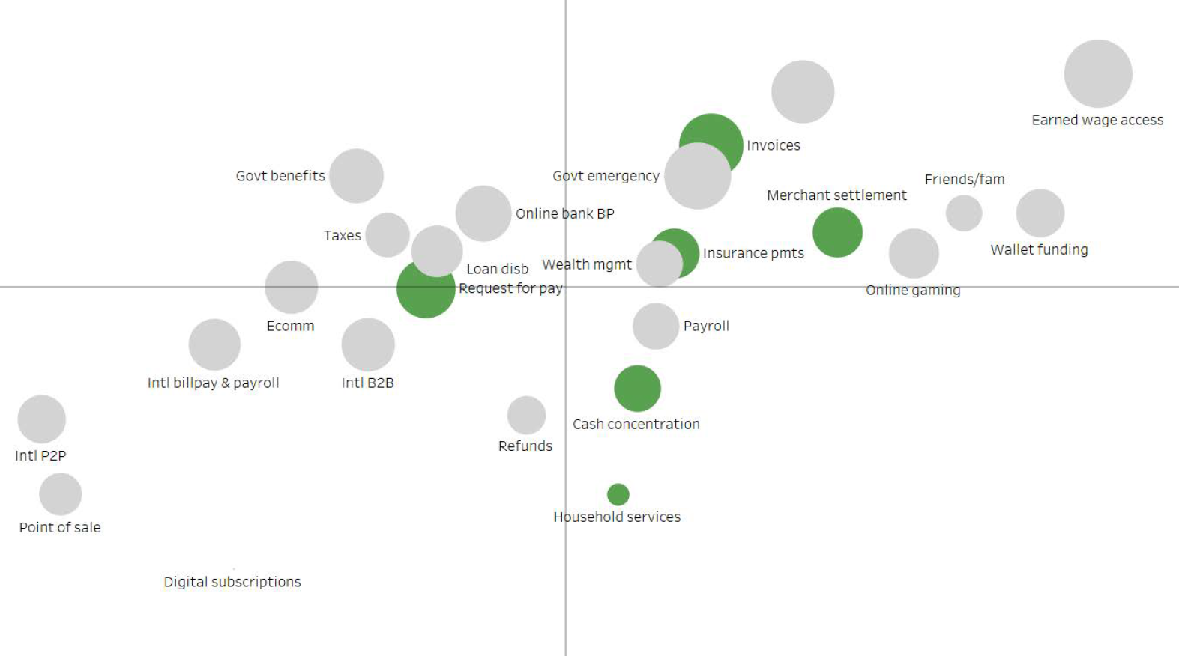
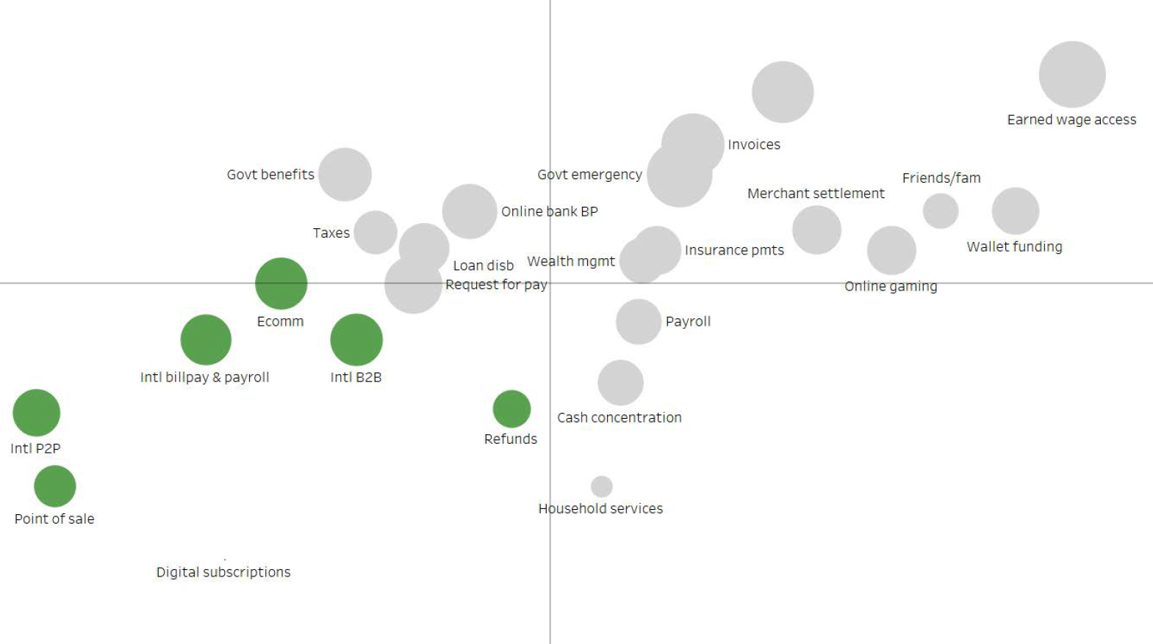
Use case insights: Detailed results in context
Third-party enablers shared views into the timing, reach and relative benefits of use cases. These use cases were then grouped by themes for discussion.
1. Enable innovative
receipt today
2. Enable strategic sender
and receiver use cases
3. Higher value send use cases
4. Next generation
use cases
Earned wage access
Wallet funding
Online gaming
Friends and family
Payroll / payroll funding
Online banking bill pay
Taxes / tax payments
Loan disbursements (real estate, auto)
Wealth management
Govt emergency
Govt benefits
Invoice / supplier
Request for pay (bill pay)
Merchant settlement
Legal & insurance payments
Cash concentration
Household / SMB services
Ecommerce
Point-of-sale
Digital subscriptions
Refunds / rebates
International bill pay/payroll
International P2P
International B2B
Notes:
It won’t be like pix who has POS upper right
B2B – seems like a pivotal use case.
RFP – bill payment is the natural fit – online banking bill pay is a natural precursor. Niches where RFP could be exciting: utility bill payment. Can also help to build a directory. Verizon has 50-70M accounts.
Stores with a high ticket price like Lowes or HD. Contractor service.
Healthcare like urgent care and dental. They don’t want interchange.
Travel airlines and fees
HH and SMB payments… contractors and tradespeople don’t want to wait for their pay.

Slide 10
Benefit insights: In respondents’ own words
When asked about the most important benefits, delivering value to customers is evident – from helping businesses better manage cash flow to enabling working Americans reap the perks of instant funds availability. Fostering seamless, end-to-end service levels through mobile enablement and ancillary tools were viewed as critical benefits in advancing adoption.
“Customers want instant payments without specifically asking for them.”
Better services
Activating key use cases
Enabling end to end
“Improved cash flow, greater funds certainty, and enhanced transaction data for surrounding process improvements, such as reconciliation of accounts payable/receivable.”​
“Government adoption of payments for Federal, State and local (e.g., moving payroll, Social Security, SNAP and other benefits, unemployment payments).”
“Highlighting instant payroll as a benefit to attract and retain employees​.”
“Instant payroll is win-win for businesses and employees.”
“Disbursements from mobile apps that an end user can carry a balance; and being able to transfer that to a standard banking account in real time.”
“FIs enabling their customers to use APIs to support instant payment sending.​”
“Instant account verification by doing micro-deposits.”​
What is the most exciting bank or customer benefit story that you have heard which would build momentum for the development of instant payments?

Slide 11
Quantifying benefits of instant payments over time
Respondents highlighted three groups of benefits that will grow over time as the network matures. ❶ Innovate and retain: Improved customer retention and innovation for end customers in the near term. ❷ Differentiate and grow: Helping institutions better attract next-gen customers and deposits in competitive markets in midterm. ❸ Realize fuller benefits: Growing revenue and improving services to the underbanked as new use cases grow the network.
Benefits Expected
Timing
1. Innovate/retain
2024-2025
2. Differentiate/grow
2025-2026
3. Fuller benefits
2027-2028
For each of the instant payment business benefits shown below, how would you assess their relative level of benefit and the timing that your customers can expect the benefit to materialize? (1 = Lower Benefit, 3 = Higher benefit)

Slide 12
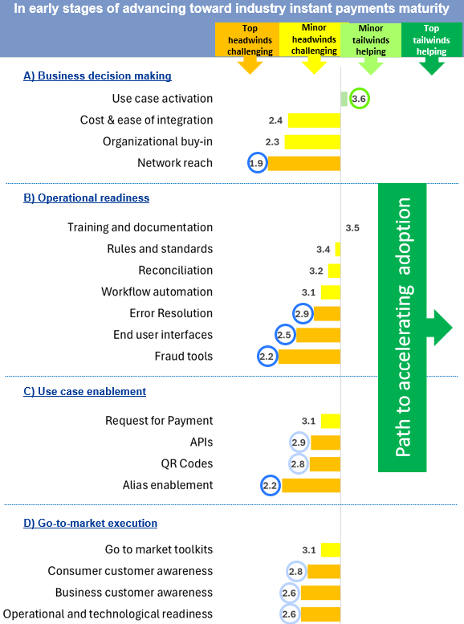
Looking forward: Quantifying relative headwinds and tailwinds
Ranking alternative factors needed to realize adoption highlights that there is considerable work to be done in the coming years, often use case specific. Some use cases are ready to move forward now; others may require additional action. Respondents note that the following will be critical to realizing these adoption outlooks:
Activating additional use cases over time (the only factor rated by third-party enablers as a tailwind in mid-2024, and as a result is shaded light green).
Advancing fraud tools, error resolution, alias enablement and user interfaces to grow network reach and usage.
Advancing other technology applications like QR codes, APIs and request for pay, thereby driving account-holder awareness.
One area for follow-on discussion will be the differences seen in past FPC barometer surveys and this survey around the potential need for enhanced work-around rules and standards, training and go-to-market tool kits identified by financial institutions.
A
B
A
B
B
B
B
C
C
C
B
C
C
C
For each of the following conditions listed below, please indicate whether you think it is a “headwind,” slowing adoption, or a “tailwind,” helping drive adoption (where 1=major headwind and 6=major tailwind)

Slide 13
Looking forward: In respondents’ own words
Respondents shared ideas of what would be most important for the industry in the near-, mid- and longer-term, in addition to the considerable detail and insight they shared throughout the quantitative parts of the survey. Highlights are included below.
Near Term
Grow receiver network
“The biggest success for instant payments has been successfully bringing TCH’s RTP, FedNow and Zelle from concept to implementation.” “Leveraging two strong instant payments networks. Start with bilateral agreements first.”
“Rapid adoption by FIs to enable receipt of instant payments.”
“Leverage fintech partnerships with institutions (i.e., digital wallets, gig economy).”
Mid-term Accelerate sender network
“Confirmation of payee to prevent push fraud.” “Payment options that do not require sharing account numbers” “Alias service enablement” "Removing barriers to support PSPs, aggregators and fintechs, to drive the advancement of digital overlays will be necessary to reach more use cases."
"Encourage sender use-case adoption/usage, and incent it where necessary… Federal, state and local government adoption of payments for Fed and USPS payroll, Social Security, SNAP and other benefits, unemployment payments"
Longer-term:
Extend use cases
“Prioritizing the support for bank online channels, batch capabilities, and API access for advanced corporates... “
“POS integration, loan disbursements, leveraging remittance capabilities, and overhauling billing/invoice procedures, among others.”
“Cross border instant payments”
What actions should be prioritized in the near-term to accelerate adoption of instant payments (12-24 months?)
What actions should be prioritized over the mid-term to accelerate adoption of instant payments (24-48 months)?
What actions should be prioritized in the long term to accelerate adoption of instant payments (5+ years)?

Slide 14
Faster Payments Council Work Stream Alignment
The FPC’s work groups are aligned to our three areas of strategic focus, leveraging our members’ knowledge and expertise to accelerate usage of instant payments. This slide maps needed areas of focus identified by survey of third-party enablers to specific FPC workstreams.
FPC Focus Areas
Reach
Growing the reach of the networks
Experience Developing the user experience
Trust Enhancing user trust
Needed Focus
(Study ratings, scale 1-6,
1=Headwind, 6=tailwind)
Network Reach 1.9
Consumer Customer Awareness 2.8
Business Customer Awareness 2.6
Use Case Activation 3.6
End User Interfaces 2.5
Alias Enablement 2.2
APIs 2.9
QR Codes 2.8
Fraud tools 2.2
Error Resolution 2.9
Rules and Standards (3.4)
Training and Documentation (3.5)
FPC Work Groups
Education and Awareness
Cross-Border Payments
Business Benefits of B2B Instant Payments
Directory Models
Secure Instant and Immediate Payments APIs
QR Code Interface
Real-time Recurring
Fraud Work Group
Operational Considerations for Instant and Immediate Payments
Financial Inclusion
For each of the following conditions listed below, please indicate whether you think it is a “headwind,” slowing adoption, or a “tailwind,” helping drive adoption (where 1=major headwind and 6=major tailwind)

Slide 15
Appendix: Objectives, methodology and respondent profile
This study surveyed core processors, bankers’ banks, corporate credit unions and fintech providers. The survey instrument was shared in advance and three office hours were held to review and field questions for respondents. Sixty organizations were invited and 25 completed the detailed survey, taking approximately 45 minutes on average. The survey saw representation across market segments including among larger firms based on customer count. Collectively, these respondents serve over 90% of U.S. institutions.
Objectives:
Quantify the current state and outlook for instant payments adoption by financial institutions.
Gather information that is representative of the broader market of U.S.-based financial institutions.
Document industry experts’ views on use case priorities, market headwinds and tailwinds, fraud mitigation, and ideas for next collective industry strategies in the near-, mid- and longer-term and experience with fraud.
The following results were reviewed at the U.S. Faster Payments Council’s Fall 2024 meeting to help synthesize results.
Methodology
To support gathering quality data, the survey was pre-tested with several technology enablers who were members of the U.S. Faster Payments Council; three drop-in calls were hosted in July and detailed instructions were provided to answer questions.
An advance copy of the questionnaire in PDF format was emailed on June 24, 2024, and the online survey was open from July 1 – Aug. 16, 2024.
Respondent Profile:
Survey respondent makeup:
Number of institutions served:
40% serve 100 or more FIs
60% serve fewer than 100 FIs
Makeup by role of firms:
40% core processors
60% gateways, digital vendors, bankers’ banks, corporate credit unions
Respondent role:
20% - CEO/COO
30% - SVP/VP/division head
50% - Director/product manager

Slide 16
Appendix: Sponsor, contributor and normal cautions
About the sponsor and contributor to this study The Faster Payments Council (FPC) sponsored this study. FPC is an industry-led membership organization whose vision is a world-class payment system where Americans can safely and securely pay anyone, anywhere, at any time and with near-immediate funds availability. By design, the FPC encourages a diverse range of perspectives and is open to all stakeholders in the U.S. payment system. Guided by principles of fairness, inclusiveness, flexibility and transparency, the FPC uses collaborative, problem-solving approaches to resolve the issues that are inhibiting broad faster payments adoption in this country. Federal Reserve Financial Services (FRFS) was a research contributor to this study. FRFS provides payment services and seeks to foster the stability, integrity and efficiency of the nation’s monetary, financial and payment systems. It offers a comprehensive suite of payment and information services offered to financial institutions. The research, statements and findings contained in this report should not be viewed as independent academic research. For citations, please refer to this study as the Faster Payments Council (2024) “Instant Payments Adoption Outlook: Quantitative Survey of U.S. Financial Institution Enablers.”
About the survey
The survey was pre-tested with several members of the Faster Payments Council to ensure respondents would be able to answer the detailed questions. The survey was administered via a web survey and was open from late June through mid-August 2024 to provide adequate time. The instrument was shared in PDF form to facilitate advance review by multiple individuals at organizations. A detailed FAQ document was shared to support getting consistent results on a complex subject. Three office hours were hosted to field questions. Responses were reviewed to ensure consistency (in a few cases follow-up was implemented with respondents to validate). The survey took about 45 minutes on average to complete. These results were previewed at the US Faster Payments Council’s Fall 2024 meeting to stress test the analysis and provide additional context.
Normal cautions in interpreting survey and outlook data Survey data tracking behaviors and trends have well-known limitations. Survey data looking at future multi-year outcomes are even more speculative (dependent on various factors that are hard to predict and/or control for). The respondents of this survey were also providers to over 90% of US-based financial institutions with strong experience in faster, instant payments and many other services, but this study did not survey financial institutions, consumers or corporates and results should be viewed from that context (Other studies noted in the reference materials do). As always, data reviewed over time will be more valuable than individual point in time studies, allowing for iterative learning. Readers should consult a variety of sources when assessing trends, outlooks and potential implications.

Slide 17
Appendix: References
FPC (2023). 2023 Faster Payments Barometer
FPC (2024). Faster Payments and Financial Inclusion
FPC (2024). How QR Codes Address 'the Last Mile' Adoption of Faster Payments at the Point-of-Sale
FPC (2024). Faster Payments Fraud Trends and Mitigation Opportunities (Bulletin.01)
FPC (2022). International Best Practices in Directory Models
FRFS (2024). Scam Information Sharing Industry Work Group
FRFS (2024). Consumer Payments Insights Brief
FRFS (2024). Business Payments Insights Brief
FRFS (2024). ScamClassifier Model
FRFS (2023). FraudClassifer Model

Slide 18
Appendix: Activate additional innovative receipt today
Respondents shared views into the timing, reach and relative benefits of use cases. The darker shaded and larger bubbles are seen as being relatively high benefit. The combined assessments identified earned wage access, payroll funding, invoice payments and government emergency disbursements as having the greatest benefit overall. Blue halo use cases indicate respondents selected them as delivering the most benefit for the least effort in the shortest time.
Higher
Reach
1. Enable innovative
receipt today
Earned wage access
Wallet funding
Online gaming
Friends and family
LARGER/DARKER BUBBLE SIZE
= Higher relative benefit
BLUE HALO
= Use cases third party enablers identified as top-3 priority
Lower
Reach
Ready Later (3-4 years)
Ready Sooner (within 1 year)

Slide 19
Appendix: Activate strategic sender and receiver use cases
Respondents shared views into the timing, reach and relative benefits of use cases. The darker shaded and larger bubbles are seen as being relatively high benefit. The combined assessments identified earned wage access, payroll funding, invoice payments and government emergency disbursements as having the greatest benefit overall. Blue halo use cases indicate respondents selected them as delivering the most benefit for the least effort in the shortest time.
Higher
Reach
2. Enable strategic sender
and receiver use cases
Payroll / Payroll funding
Online banking bill pay
Taxes / tax payments
Loan disbursements (real estate, auto)
Wealth management
Govt emergency
Govt benefits
LARGER/DARKER BUBBLE SIZE
= Higher relative benefit
BLUE HALO
= Use cases third party enablers identified as top-3 priority
Lower
Reach
Ready Later (3-4 years)
Ready Sooner (within 1 year)

Slide 20
Appendix: Activate higher value send use cases
Respondents shared views into the timing, reach and relative benefits of use cases. The darker shaded and larger bubbles are seen as being relatively high benefit. The combined assessments identified earned wage access, payroll funding, invoice payments and government emergency disbursements as having the greatest benefit overall. Blue halo use cases indicate respondents selected them as delivering the most benefit for the least effort in the shortest time.
Higher
Reach
3. Higher value send use cases
Merchant settlement
Invoice / supplier
Cash concentration
Legal & insurance payments
Request for pay (bill pay)
Household / SMB services
LARGER/DARKER BUBBLE SIZE
= Higher relative benefit
BLUE HALO
= Use cases third party enablers identified as top-3 priority
Lower
Reach
Ready Later (3-4 years)
Ready Sooner (within 1 year)

Slide 21
Appendix: Activate next generation use cases
Respondents shared views into the timing, reach and relative benefits of use cases. The darker shaded and larger bubbles are seen as being relatively high benefit. The combined assessments identified earned wage access, payroll funding, invoice payments and government emergency disbursements as having the greatest benefit overall. Blue halo use cases indicate respondents selected them as delivering the most benefit for the least effort in the shortest time.
Higher
Reach
4. Next generation
use cases
Ecommerce
Digital subscriptions
Refunds / rebates
Point-of-sale
International bill pay/payroll
International P2P
International B2B
LARGER/DARKER BUBBLE SIZE
= Higher relative benefit
BLUE HALO
= Use cases third party enablers identified as top-3 priority
Lower
Reach
Ready Later (3-4 years)
Ready Sooner (within 1 year)

